Slide 1
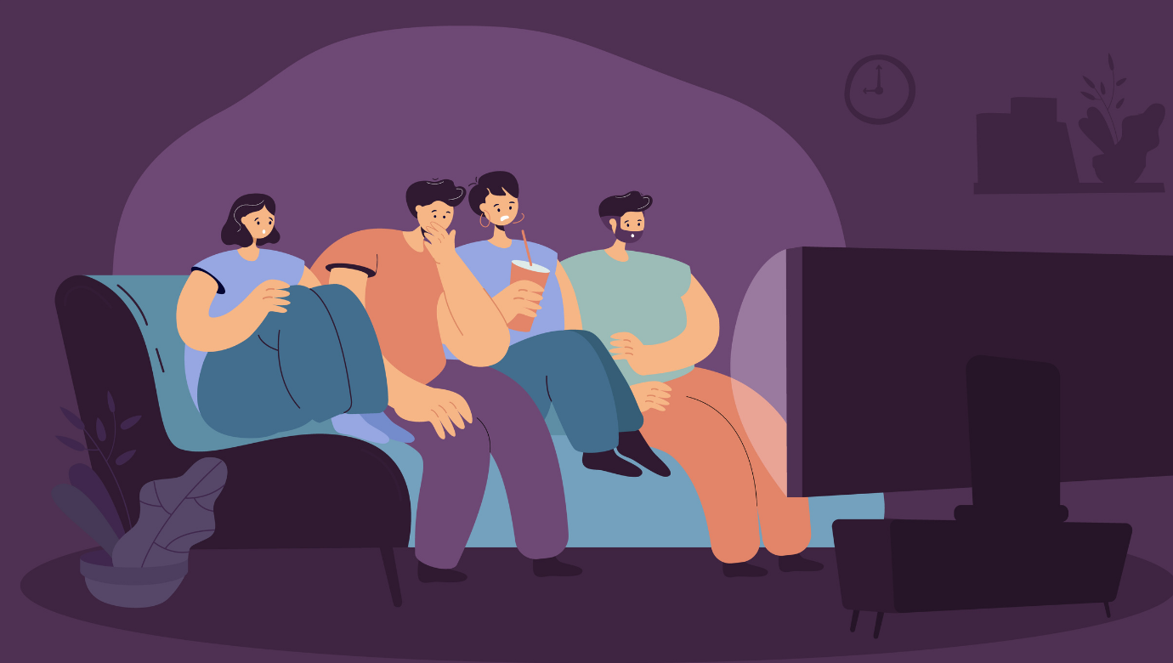
Films L3 Sciences de l’éducation
Notes:
To get an editable version of this presentation:
1. Click File > Make a copy > Entire presentation
OR
2. Click File > Download > Microsoft Powerpoint

Slide 2
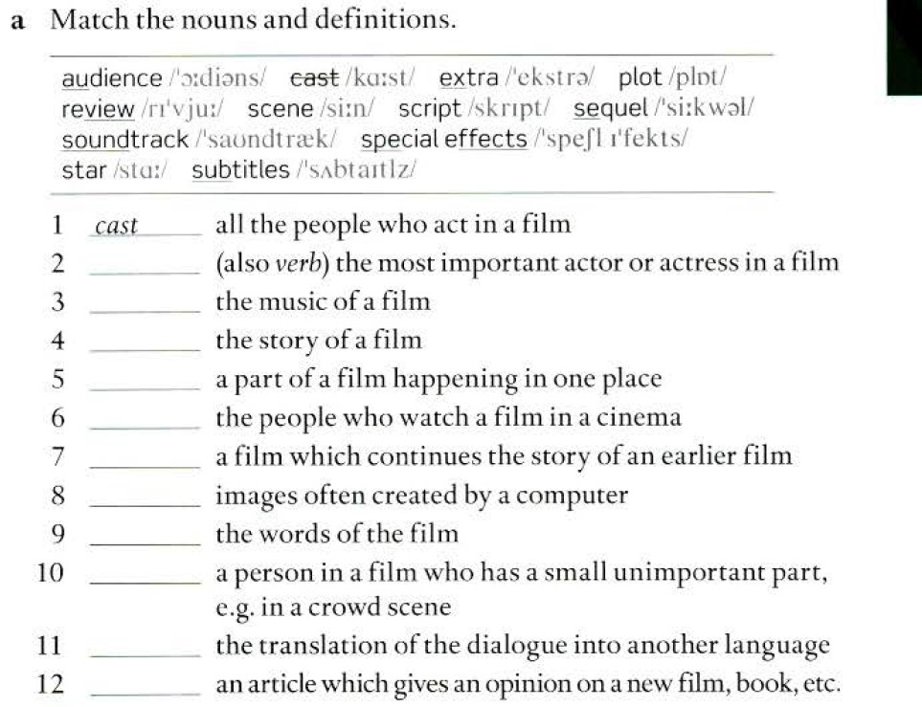
2. Star
3. Soundtrack
4. Plot
5. Scene
6.Audience
7.Sequel
8. Special effects
9. Script
10. Extra
11 Subtitles
12 review

Slide 3
1.B
2.D
3. C
4. A
5. E
6.F

Slide 4
Decide which types of films you might hear these quotes in. Two film types are not used. [part 1/2]
action film cartoon comedy documentary drama
horror film romantic film science-fiction film thriller
“I came here tonight because I realised that I want to spend the rest of my life with you.”
“There are half as many African lions as there were 25 years ago.”
“This baby was born on Mars.”
quote (noun):
words that someone else has said or written

Slide 5
Decide which types of films you might hear these quotes in. Two film types are not used. [part 2/2]
action film cartoon comedy documentary drama
horror film romantic film science-fiction film thriller
“He doesn’t look like the rabbit in the photo.”
“My favourite vegetables are chips.”
“The building is on fire! We need to save those people!”
“I don’t believe in ghosts! I’m just going to see what’s going on outside.”
quote (noun):
words that someone else has said or written

Slide 6
Let’s check your answers.
action film cartoon comedy documentary drama
horror film romantic film science-fiction film thriller
“I came here tonight because I realised that I want to spend the rest of my life with you.”
“There are half as many African lions as there were 25 years ago.”
“This baby was born on Mars.”
“He doesn’t look like the rabbit in the photo.”
“My favourite vegetables are chips.”
“The building is on fire! We need to save those people!”
“I don’t believe in ghosts! I’m just going to see what’s going on outside.”
romantic film
documentary
science-fiction film
cartoon
comedy
action film
horror film

Slide 7
Look at some scenes from films and discuss the questions below. [part 1/2]
What are the people doing? How are they probably feeling?
What is going to happen next?
What type of films are they? Why do you think so?
Would you like to watch the films? Why/Why not?

Slide 8
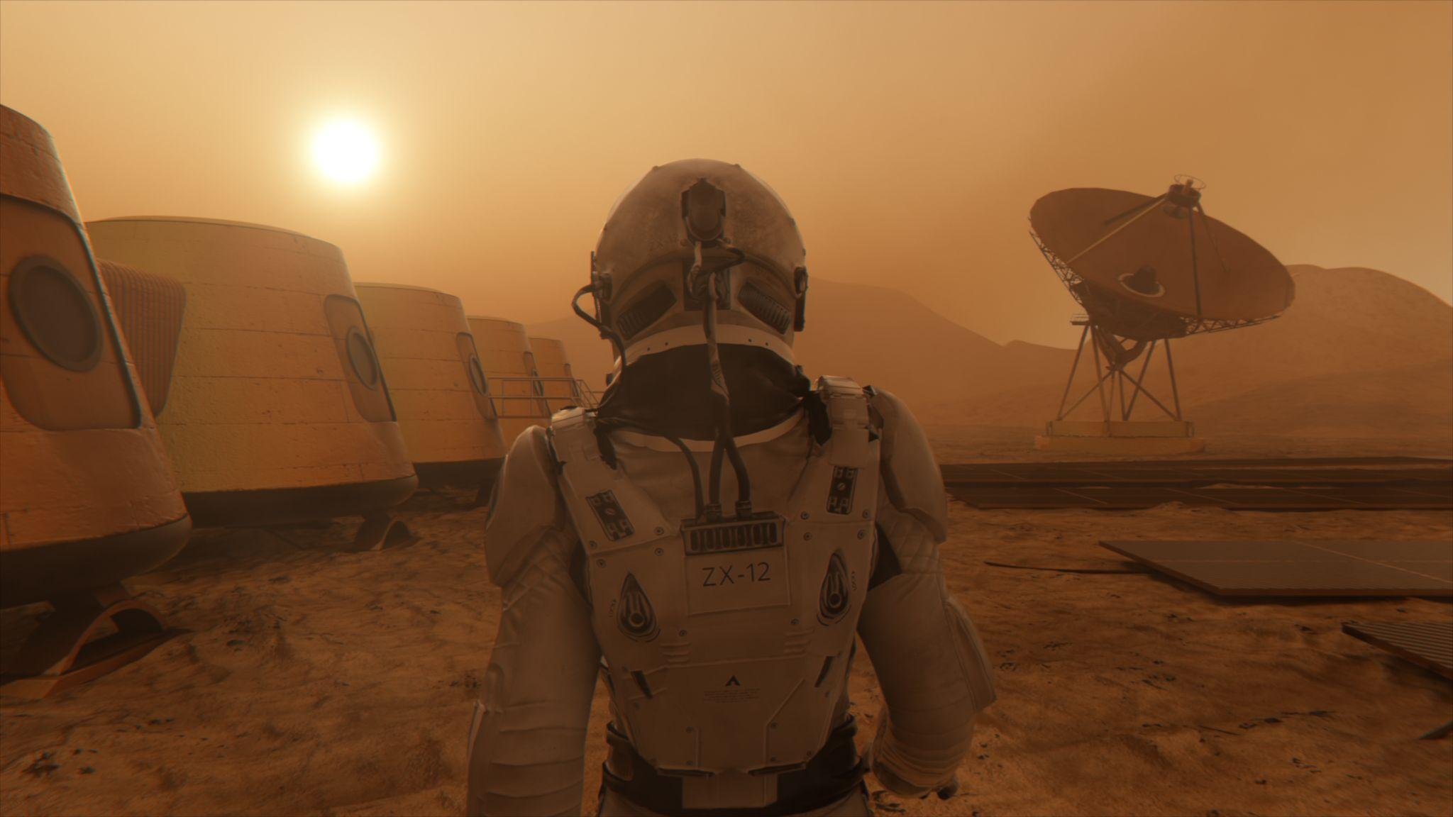
Look at some scenes from films and discuss the questions below. [part 2/2]
What are the people doing? How are they probably feeling?
What is going to happen next?
What type of films are they? Why do you think so?
Would you like to watch the films? Why/Why not?

Slide 9
Let’s learn some vocabulary

Slide 10
Look at the words and phrases in bold and answer the questions below. [part 1/7]
I watch films in English with subtitles in my language.
I have a favourite soundtrack which I often listen to.
When I want to see a film, I watch trailers online to find something I like.
I don’t like watching films with dubbing because the actors’ mouths never move as they should.
After watching a good film, I check the cast list to see the actors’ names.
I hate spoilers because I don’t want to know how the film ends before I watch it.
I usually know the titles of English films in my language, but not in English.
If the main character is played by a bad actor, a film can’t be good.
Watching a series is better than watching a film because the story is longer and you can watch it for weeks.
The story in films is more important than the special effects.
Which two words or phrases are sounds in a film?

Slide 11
Look at the words and phrases in bold and answer the questions below. [part 2/7]
I watch films in English with subtitles in my language.
I have a favourite soundtrack which I often listen to.
When I want to see a film, I watch trailers online to find something I like.
I don’t like watching films with dubbing because the actors’ mouths never move as they should.
After watching a good film, I check the cast list to see the actors’ names.
I hate spoilers because I don’t want to know how the film ends before I watch it.
I usually know the titles of English films in my language, but not in English.
If the main character is played by a bad actor, a film can’t be good.
Watching a series is better than watching a film because the story is longer and you can watch it for weeks.
The story in films is more important than the special effects.
Which two words or phrases are text on the screen
at the beginning of or during a film?

Slide 12
Look at the words and phrases in bold and answer the questions below. [part 3/7]
I watch films in English with subtitles in my language.
I have a favourite soundtrack which I often listen to.
When I want to see a film, I watch trailers online to find something I like.
I don’t like watching films with dubbing because the actors’ mouths never move as they should.
After watching a good film, I check the cast list to see the actors’ names.
I hate spoilers because I don’t want to know how the film ends before I watch it.
I usually know the titles of English films in my language, but not in English.
If the main character is played by a bad actor, a film can’t be good.
Watching a series is better than watching a film because the story is longer and you can watch it for weeks.
The story in films is more important than the special effects.
Which two words or phrases are people in a film?

Slide 13
Look at the words and phrases in bold and answer the questions below. [part 4/7]
I watch films in English with subtitles in my language.
I have a favourite soundtrack which I often listen to.
When I want to see a film, I watch trailers online to find something I like.
I don’t like watching films with dubbing because the actors’ mouths never move as they should.
After watching a good film, I check the cast list to see the actors’ names.
I hate spoilers because I don’t want to know how the film ends before I watch it.
I usually know the titles of English films in my language, but not in English.
If the main character is played by a bad actor, a film can’t be good.
Watching a series is better than watching a film because the story is longer and you can watch it for weeks.
The story in films is more important than the special effects.
What is something you can’t watch at the cinema
but can watch at home?

Slide 14
Look at the words and phrases in bold and answer the questions below. [part 5/7]
I watch films in English with subtitles in my language.
I have a favourite soundtrack which I often listen to.
When I want to see a film, I watch trailers online to find something I like.
I don’t like watching films with dubbing because the actors’ mouths never move as they should.
After watching a good film, I check the cast list to see the actors’ names.
I hate spoilers because I don’t want to know how the film ends before I watch it.
I usually know the titles of English films in my language, but not in English.
If the main character is played by a bad actor, a film can’t be good.
Watching a series is better than watching a film because the story is longer and you can watch it for weeks.
The story in films is more important than the special effects.
What can you often watch at the cinema before a film?

Slide 15
Look at the words and phrases in bold and answer the questions below. [part 6/7]
I watch films in English with subtitles in my language.
I have a favourite soundtrack which I often listen to.
When I want to see a film, I watch trailers online to find something I like.
I don’t like watching films with dubbing because the actors’ mouths never move as they should.
After watching a good film, I check the cast list to see the actors’ names.
I hate spoilers because I don’t want to know how the film ends before I watch it.
I usually know the titles of English films in my language, but not in English.
If the main character is played by a bad actor, a film can’t be good.
Watching a series is better than watching a film because the story is longer and you can watch it for weeks.
The story in films is more important than the special effects.
What are explosions, storms or aliens in films?

Slide 16
Look at the words and phrases in bold and answer the questions below. [part 7/7]
I watch films in English with subtitles in my language.
I have a favourite soundtrack which I often listen to.
When I want to see a film, I watch trailers online to find something I like.
I don’t like watching films with dubbing because the actors’ mouths never move as they should.
After watching a good film, I check the cast list to see the actors’ names.
I hate spoilers because I don’t want to know how the film ends before I watch it.
I usually know the titles of English films in my language, but not in English.
If the main character is played by a bad actor, a film can’t be good.
Watching a series is better than watching a film because the story is longer and you can watch it for weeks.
The story in films is more important than the special effects.
What are very important pieces of information that people shouldn’t know if they want to be surprised by a film?

Slide 17
Let’s check your answers.
Which two words or phrases are sounds in a film?
Which two words or phrases are text on the screen at the beginning of or during a film?
Which two words or phrases are people in a film?
What is something you can’t watch at the cinema but can watch at home?
What can you often watch at the cinema before a film?
What are explosions, storms or aliens in films?
What are very important pieces of information that people shouldn’t know if they want to be surprised by a film?
soundtrack
dubbing
subtitles
titles
cast
main character
series
trailers
special effects
spoilers

Slide 18
Discuss if the sentences are true for you. Give some details.
EXAMPLE:
I watch films in English with subtitles in my language.
Usually I watch films in English with subtitles in my language. I sometimes change them to English subtitles, but then the film is very difficult to understand.

Slide 19
Discuss if the sentences are true for you. Give some details. [part 1/2]
I watch films in English with subtitles in my language.
I have a favourite soundtrack which I often listen to.
When I want to see a film, I watch trailers online to find something I like.
I don’t like watching films with dubbing because the actors’ mouths never move as they should.
After watching a good film, I check the cast list to see the actors’ names.

Slide 20
Discuss if the sentences are true for you. Give some details. [part 2/2]
I hate spoilers because I don’t want to know how the film ends before I watch it.
I usually know the titles of English films in my language, but not in English.
If the main character is played by a bad actor, a film can’t be good.
Watching a series is better than watching a film because the story is longer and you can watch it for weeks.
The story in films is more important than the special effects.

Slide 21
Decide if the adjectives describing films are positive or negative. If you can’t decide, explain why.
amusing
average
dull
fantastic
moving
scary
strange
surprising
terrible
unoriginal
violent
POSITIVE | NEGATIVE | NOT SURE
Notes:
There’s no answer slide for this task.

Slide 22
Look at the film titles. Discuss what the films could be about and decide which adjectives might be best to describe them. Explain why. [part 1/2]
EXAMPLE: The Simple Life Of Billy Bo has a strange title but it might be amusing. It could be a comedy about a funny man who doesn’t want much from life. It might be moving or surprising.
The Simple Life Of Billy Bo
Aliens Attack!
Love Is In The Air
amusing average dull fantastic moving scary strange surprising
terrible unoriginal violent

Slide 23
Look at the film titles. Discuss what the films could be about and decide which adjectives might be best to describe them. Explain why. [part 2/2]
The Generals Of World War II
Blood On Your Hands
The Shrink Next Door
Language Lessons
shrink (noun):
a therapist
amusing average dull fantastic moving scary strange surprising
terrible unoriginal violent

Slide 24
The Shrink Next Door
and
Language Lessons
In a moment, you’ll watch two film trailers titled:

Slide 25
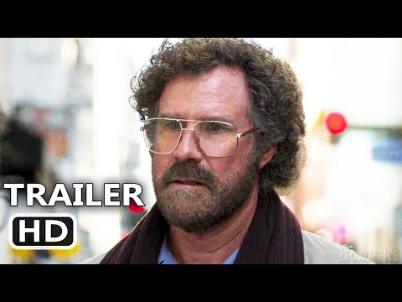
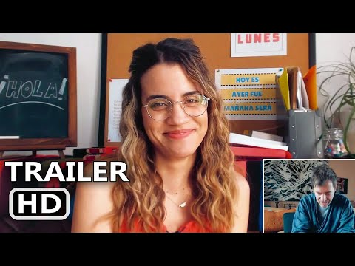
Watch the trailers and decide which of the films might be more amusing and why.
The Shrink Next Door
Language Lessons

Slide 26
Look at the quotes from the two film trailers and choose the correct words. [part 1/2]
I found …………… that it was your birthday,
1. about 2. out 3. if
You know what word I’m …………… a little tired of hearing from you?
1. feeling 2. catching 3. getting
I mean, I assume this is what drugs feel …………… .
1. like 2. as 3. than
How much will you …………… me?
1. charge 2. cost 3. pay back

Slide 27
Let’s check your answers. [part 1/2]
I found …………… that it was your birthday,
1. about 2. out 3. if
You know what word I’m …………… a little tired of hearing from you?
1. feeling 2. catching 3. getting
I mean, I assume this is what drugs feel …………… .
1. like 2. as 3. than
How much will you …………… me?
1. charge 2. cost 3. pay back

Slide 28
Look at the quotes from the two film trailers and choose the correct words. [part 2/2]
Is there …………… there?
1. nobody 2. somebody 3. anybody
And we’re …………… of time.
1. up 2. out 3. down
I just want to …………… sure that you’re ok.
1. make 2. do 3. get

Slide 29
Let’s check your answers. [part 2/2]
Is there …………… there?
1. nobody 2. somebody 3. anybody
And we’re …………… of time.
1. up 2. out 3. down
I just want to …………… sure that you’re ok.
1. make 2. do 3. get

Slide 30
Watch the trailers again and match the quotes to the trailers. There is one extra quote. [part 1/2]
I found out that it was your birthday,
You know what word I’m getting a little tired of hearing from you?
I mean, I assume this is what drugs feel like.
How much will you charge me?
Is there anybody there?
And we’re out of time.
I just want to make sure that you’re ok.
The Shrink Next Door

Slide 31
Watch the trailers again and match the quotes to the trailers. There is one extra quote. [part 2/2]
I found out that it was your birthday,
You know what word I’m getting a little tired of hearing from you?
I mean, I assume this is what drugs feel like.
How much will you charge me?
Is there anybody there?
And we’re out of time.
I just want to make sure that you’re ok.
Language Lessons

Slide 32
Let’s check your answers.
I found out that it was your birthday.
You know what word I’m getting a little tired of hearing from you?
I mean, I assume this is what drugs feel like.
How much will you charge me?
Is there anybody there?
And we’re out of time.
I just want to make sure that you’re ok.
Language Lessons
The Shrink Next Door
The Shrink Next Door
None
Language Lessons
The Shrink Next Door
Language Lessons
Notes:
TIMESTAMPS:
00:51
00:22
00:49
None
01:11
01:26
01:23

Slide 33
Discuss the questions.
Do you recognise any of the actors in the two films? Have you seen them in other films?
How many main characters were shown in the trailers?
Which of the films had English subtitles?
Would you like to watch any of the films? Why/Why not?
Should trailers have some spoilers? Why/Why not?

Slide 34
Let’s talk more!

Slide 35
Look at the options and decide which you would prefer to do. Explain why. [part 1/2]
watch a strange science fiction film or a violent horror film
watch a dull film with a friend or a fantastic film alone
listen to an unoriginal soundtrack or terrible dubbing
be an actor or a writer
watch an average comedy or a moving documentary

Slide 36
Look at the options and decide which you would prefer to do. Explain why. [part 2/2]
see an unoriginal film with a fantastic cast or a film with an amusing story but average actors
see a film that your parents recommended or that your friends recommended
watch a film at the cinema or at home
watch a whole film in English without dubbing or subtitles, or speak English for fifteen minutes

Slide 37
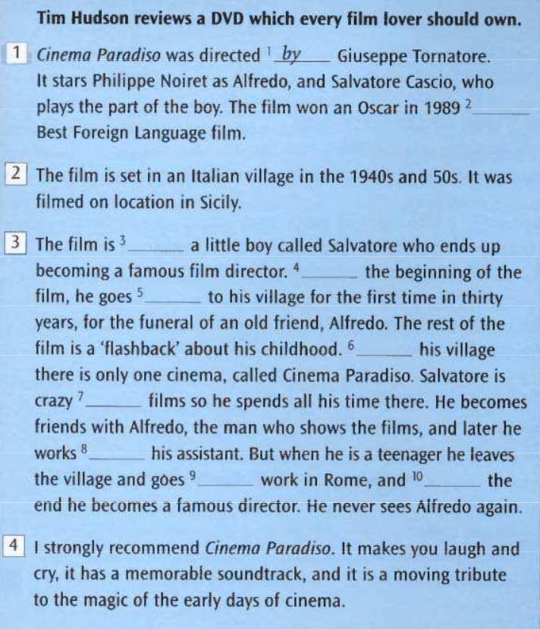

Slide 38
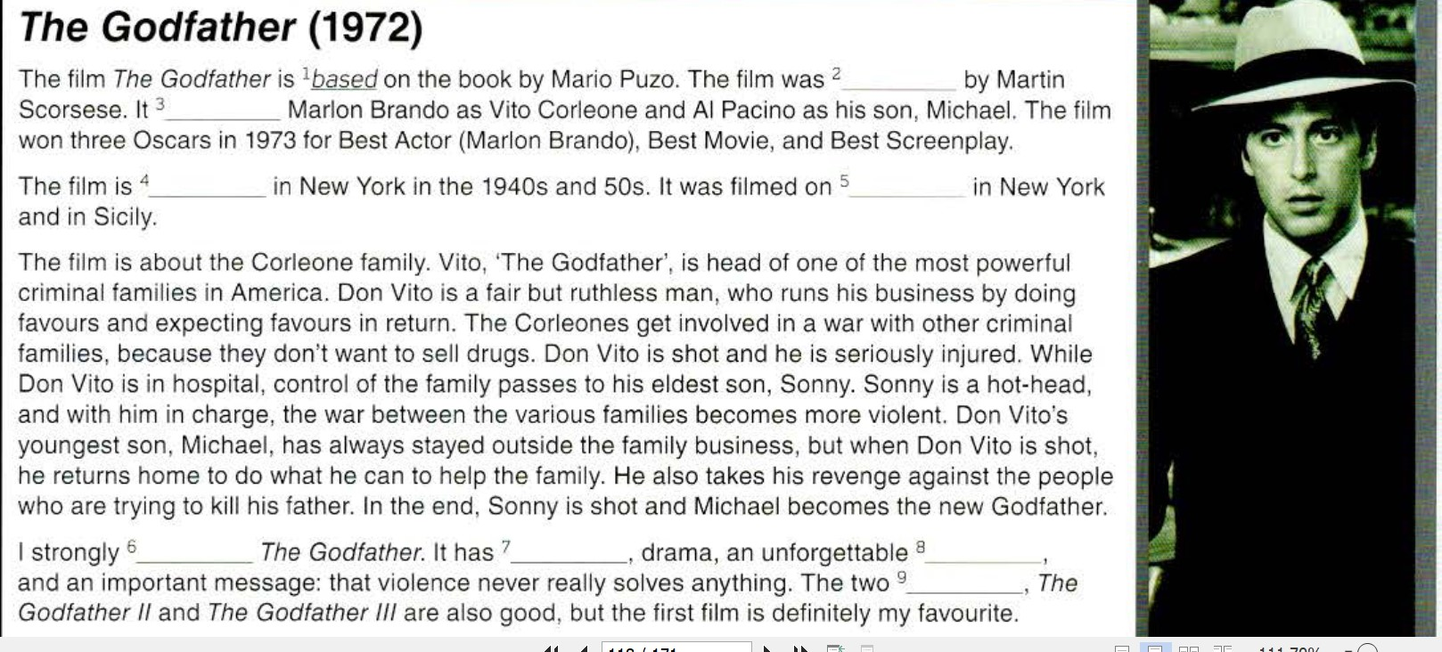

Slide 39
Classic films you must see Answers
1. Is based
2. Directed
3. Stars
4. Set
5. Location
6. Recommend
7. Action
8. Soundtrack
Paragraph 1 The name,director,stars
Paragraph 2 Where/when set and filmed
Paragraph 3 The plot
Paragraph 4 Why you recommend the film

Slide 40
Example of simplified text based on wikipedia
Original My Left Foot
In 1932, Christy Brown was born into a Dublin family of 15. Doctors discover he has severe cerebral palsy. Christy is unable to walk or talk. He is loved and supported by his family, especially his mother. One day, Christy's mother trips down the stairs while in labour and Christy was the only person home to see it. He was able to alert some neighbours and summon them over to help. Christy's father, who never believed Christy would amount to anything, starts to become proud after witnessing him use his left foot, the only body part he can fully control, to write the word "mother" on the floor with a piece of chalk…………etc
Christy Brown is the main character.He was born into a big poor Irish family. He has cerebral palsy. He can’t communicate or walk,but his mother believes he is intelligent.He is included in the family. One day he writes on the floor with a piece of chalk and the family sees he is intelligent.Later he has a wheelchair and speech therapy to learn to speak and he paints with his left foot.He becomes famous for his painting and a book he writes.

Slide 41
Jennifer Brea's Sundance award-winning documentary, Unrest, is a personal journey from patient to advocate to storyteller. Jennifer is twenty-eight years-old, working on her PhD at Harvard, and months away from marrying the love of her life when a mysterious fever leaves her bedridden. When doctors tell her it's "all in her head," she picks up her camera as an act of defiance and brings us into a hidden world of millions that medicine abandoned.
In this story of love and loss, newlyweds Jennifer and Omar search for answers as they face unexpected obstacles with great heart. Often confined by her illness to the private space of her bed, Jennifer connects with others around the globe. Like a modern-day Odysseus, she travels by Skype into a forgotten community, crafting intimate portraits of four other families suffering similarly. Jennifer Brea's wonderfully honest and humane portrayal asks us to rethink the stigma around an illness that affects millions. Unrest is a vulnerable and eloquent personal documentary that is sure to hit closer to home than many could imagine.
Imagine with a partner how you would present the information above in your film presentation.
Who is Jennifer Brea? What happens to her? What problems does she have?What does she do? What do we discover about others with this illness?

Slide 42
FILM PRESENTATION IN GROUPS.
EXAMPLE STORY SUMMARY of film watched in S1
The film we are going to present is a documentary about Jennifer Bréa. The documentary has won prizes. Jennifer was a brilliant student at Harvard and she was about to get married. When she was 28 she became ill with a temperature and then she couldn’t get out of bed.
Some doctors told her she wasn’t ill,but her problems were all in her head.
Jennifer spent much time in bed. It was difficult for her and her husband. From her bed she contacted other people with the same problems and she made a film about them and their families.She discovered there were millions of people like her,who felt abandoned by medecine.
In the film we see and honest portrait of how the different families manage to deal wih their illness and feel forgotton by the world.

Slide 43
Presentation continued
THE DISABILITY
Myalgic encephalomyelitis
M.E Chronic Fatigue Syndrome
Explanation, statistics, millions missing, symptoms ,diagnosis, link with long covid
THE CHARACTERS
Examples of the people Jennifer met via the Internet
A SCENE
Clip of the Danish girl put in a psychiatric hospital
Discussion of the issues raised
YOUR REACTIONS
Similar what you wrote in class in S1

Slide 44
Thanks!

